Slide 1
CREDIT CARD FRAUD ANALYSIS
AML Group Project Presentation
By
M.Surendran(2348527)
Sanjay S( 2348553)
Victor Jose IJ(2348570)
Department of Computer Science
CHRIST(Deemed to be University),
Bengaluru-29

Slide 2
1.AIM OF THE PROJECT
Credit Card Frauds are the cases of using someone else's credit cards for financial transactions without the information of the card owner. Credit Cards were made available in order for the people to increase their buying power, it is an agreement with your bank that lets the user use the money lended by the bank in exchange for the repayment of this lended money on the due date or incur interest charges. As all the things in the nature are binary, cases of credit card frauds has also achieved high numbers. Thus, building automated models for such a rising problem statement is necessary and AI - ML is the key for it.
To classify whether a credit card transaction is fradulent or genuine and handle unbalanced dataset.
It is a classification problem with highly unbalanced data.

Slide 3
2. DATASET USED & DESCRIPTION OF DATASET
The dataset used for this project is the "Credit Card fraud detection" dataset, which can be found on Kaggle at the following link: https://www.kaggle.com/datasets/mlg-ulb/creditcardfraud
The dataset contains transactions made through credit cards by European cardholders. This dataset presents transactions that occurred in two days, where we have 492 frauds out of 284,807 transactions.
The dataset is highly unbalanced, the positive class (frauds) account for 0.172% of all transactions.
The dataset is organized into several columns, including V1-V28, Time, Amount, & Class .

Slide 4
COLUMNS IN DATASET
V1, V2, … V28 - It is the principal components obtained with PCA, the only features which have not been transformed with PCA are 'Time' and 'Amount'.
Time – It contains the seconds elapsed between each transaction and the first transaction in the dataset.
Amount - It is the transaction Amount, this feature can be used for example-dependant cost-sensitive learning.
Class - It is the response variable and it takes value 1 in case of fraud and 0 otherwise.

Slide 5
SUMMARY OF THE DATA SET
The dataset contains transactions made through credit cards by European cardholders.
This dataset presents transactions that occurred in two days.
It contains 492 frauds out of 284,807 transactions.
The dataset is highly unbalanced, the positive class (frauds) account for 0.172% of all transactions.
It contains only numerical input variables which are the result of a PCA transformation.

Slide 6
3. DATA PREPROCESSING & EXPLORATORY DATA ANALYSIS(EDA)
The dataset comprises 284,807 credit card transactions, of which only 492 are labeled as fraudulent, resulting in a highly imbalanced class distribution.
It initially explore the data to gain insights into the underlying patterns and trends.
It employ descriptive statistics, correlation analysis, and visualization techniques to identify potential indicators of fraudulent transactions.

Slide 7
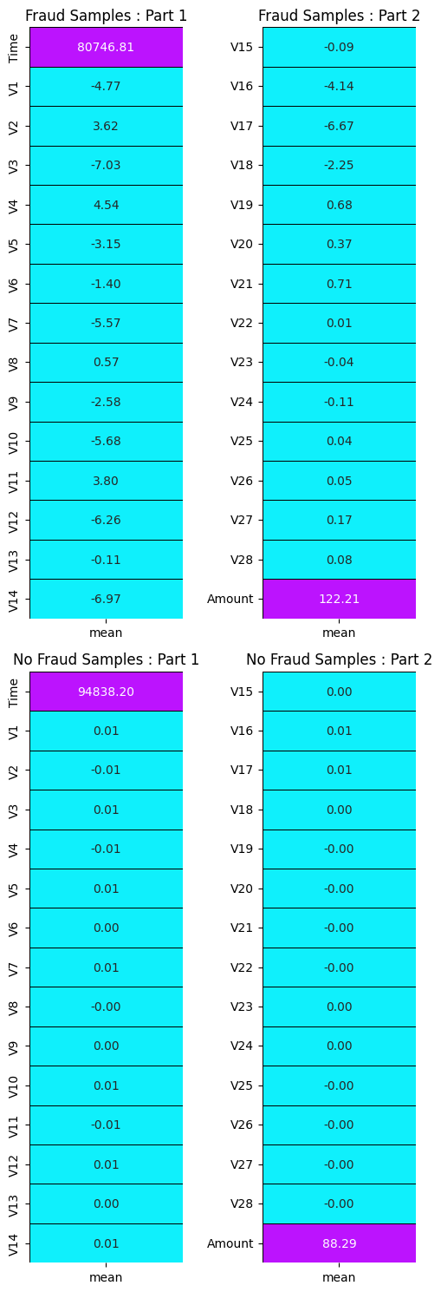
HEAT MAP:

Slide 8
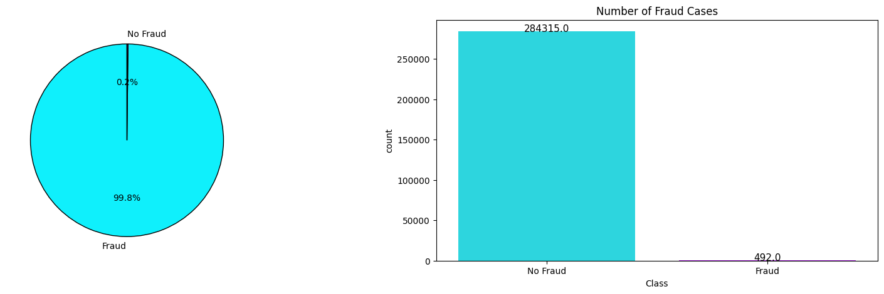
VISUALIZATION:

Slide 9
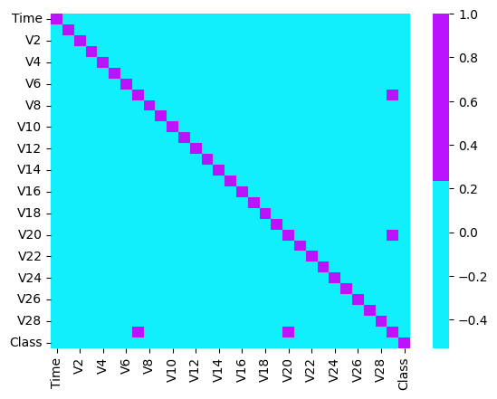
CORRELATION MATRIX:

Slide 10
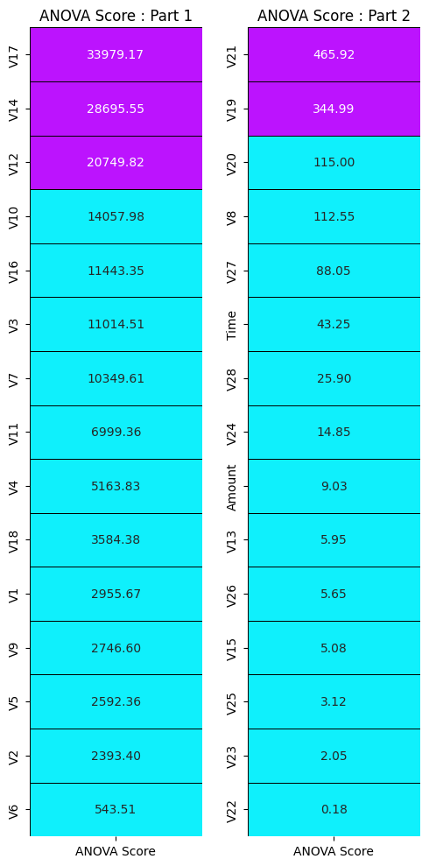
HEAT MAP FOR ANOVA SCORE:

Slide 11
4. DIFFERENT MACHINE LEARNING MODEL AND ITS ACCURACY
Logistic Regression
Support Vector Classifier
Decision Tree Classifier
Random Forest Classifier
K-nearest Neighbors(KNN)
Isolation Forest

Slide 12
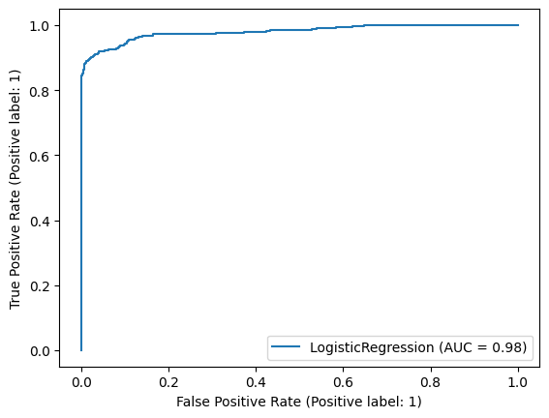
LOGISTIC REGRESSION
A widely used classification algorithm that models the relationship between independent variables and a binary target variable.
ROC CURVE:

Slide 13
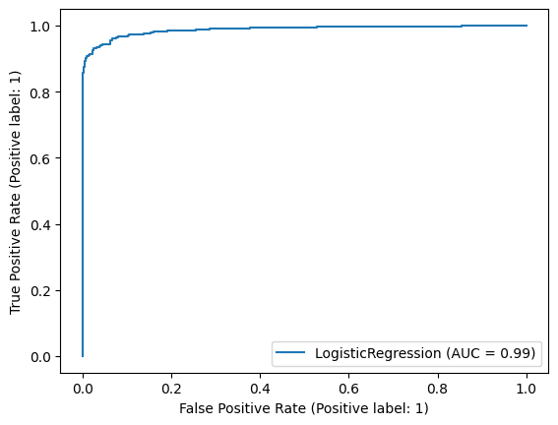
ROC CURVE FOR ANOVA SCORE:

Slide 14
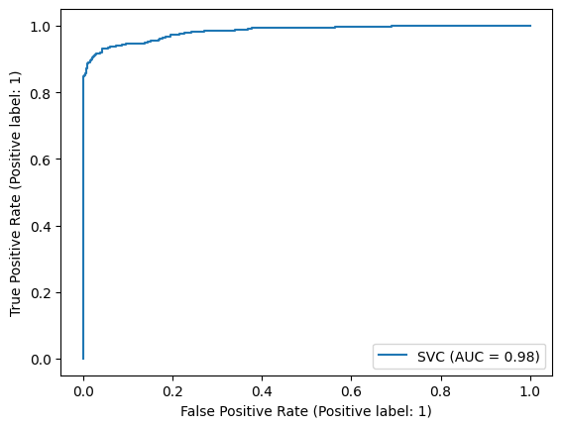
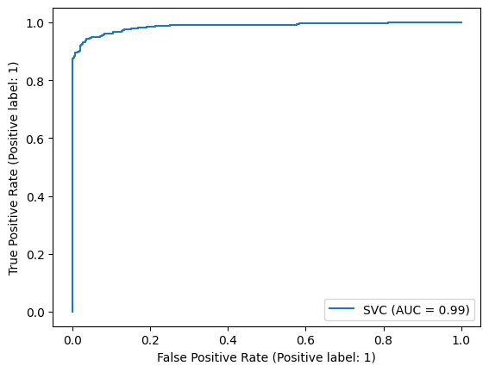
SUPPORT VECTOR CLASSIFIER
A powerful algorithm that constructs hyperplanes to separate data points belonging to different classes.
ROC CURVE
ROC CURVE FOR ANOVA SCORE

Slide 15
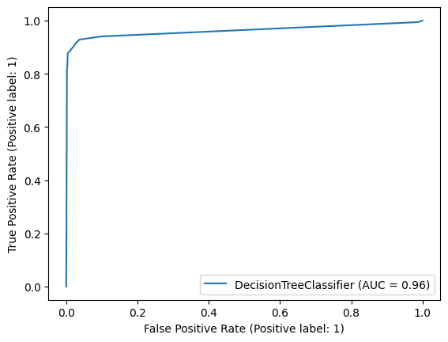
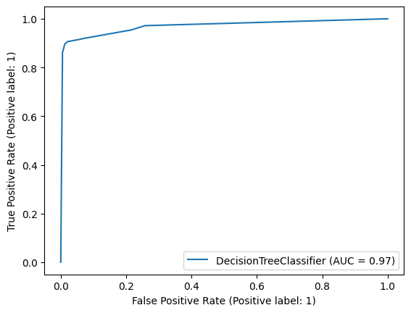
DECISION TREE CLASSIFIER
A non-linear classification algorithm that builds a tree-like structure to make decisions based on the values of input features.
ROC CURVE
ROC CURVE FOR ANOVA SCORE

Slide 16
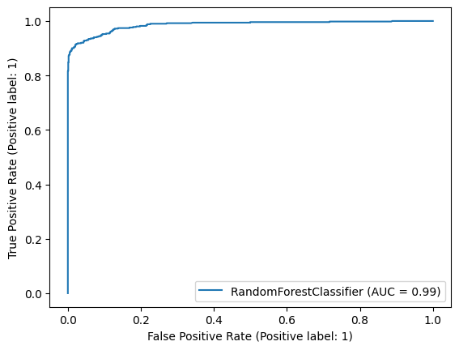
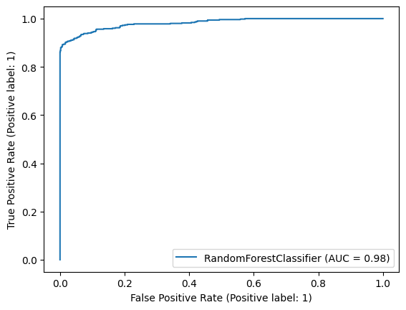
RANDOM FOREST CLASSIFIER
An ensemble learning algorithm that combines multiple decision trees to improve generalization performance.
ROC CURVE
ROC CURVE FOR ANOVA SCORE

Slide 17
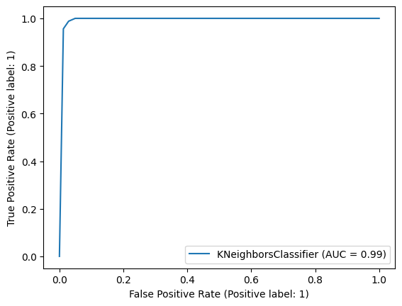

K-NEAREST NEIGHBORS(KNN)
A simple yet effective algorithm that classifies data points based on their similarity to neighboring data points.
ROC CURVE
ROC CURVE FOR ANOVA SCORE

Slide 18
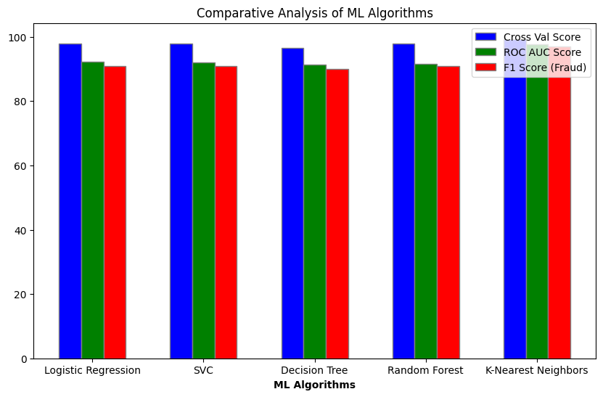
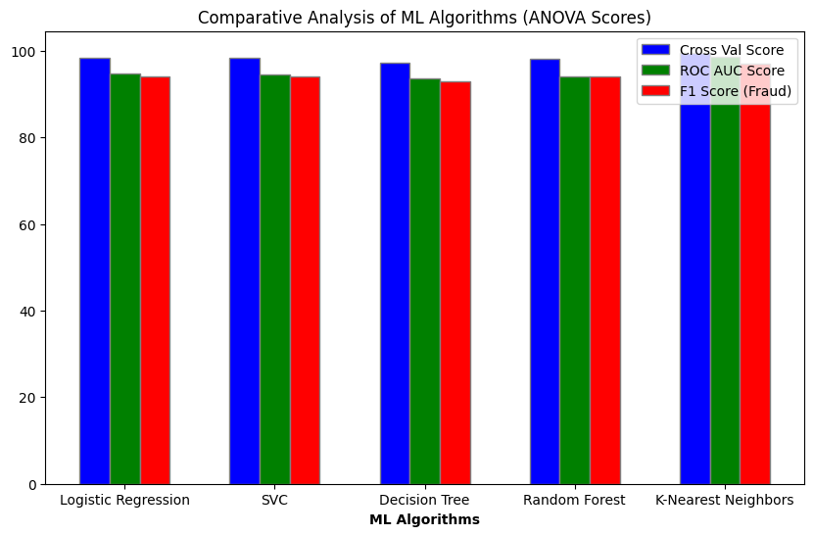
5. COMPARATIVE CHART ON NORMAL AND SCORE FOR MACHINE LEARNING MODELS
ANOVA SCORE:

Slide 19
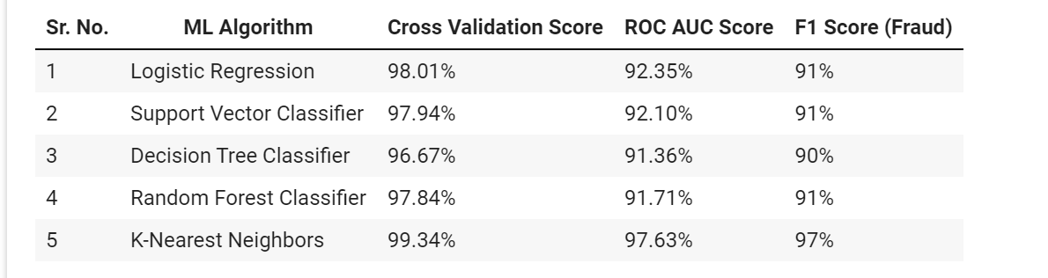
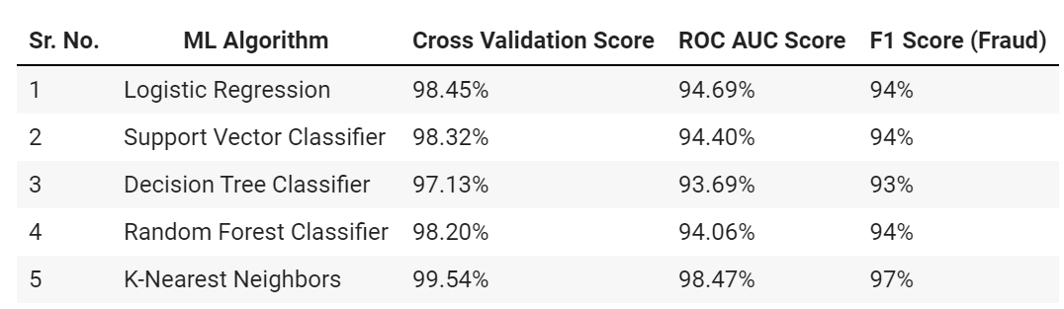
Results Table for models based on confusion matrix :
Results Table for models based on ANOVA Score :

Slide 20
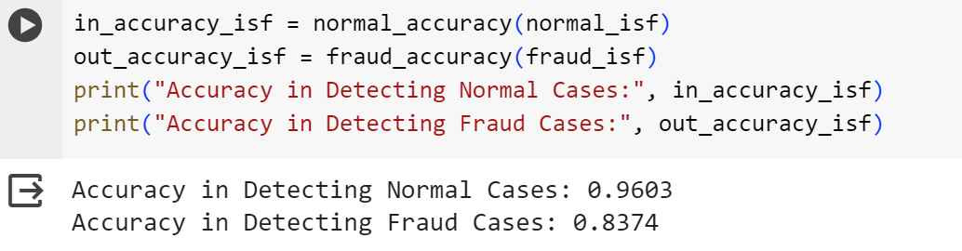
ISOLATION FOREST
Isolation Forest detects anomalies using binary trees. The algorithm has a linear time complexity and a low memory requirement, which works well with high-volume data.

Slide 21
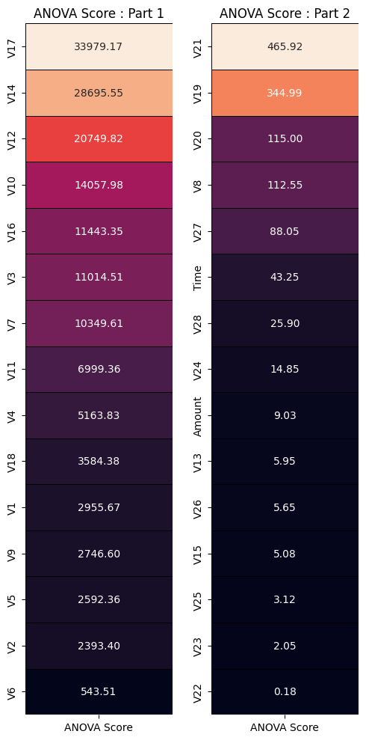
LOCAL OUTLIER FACTOR
The Local Outlier Factor (LOF) algorithm is an unsupervised anomaly detection method which computes the local density deviation of a given data point with respect to its neighbors.

Slide 22
6. CONCLUSION
This is a great dataset to learn about classification problem with unbalanced data.
As the features are disguised, feature selection cannot be assisted based on the domain knowledge of the topic. Statistical tests hold the complete importance to select features for modeling.
Due to the use of SMOTE analysis for balancing the data, the models trained on this synthetic data cannot be evaluated using accuracy. Hence, we resort to Cross Validation Score and ROC-AUC Score for model evaluation.
In this K-Nearest Neighbors is the best algorithim based on confusion matrix(Cross Validation Score=99.34%, ROC AUC Score=97.63,F1 Score=97% and based on ANOVA Score(Cross Validation Score=99.54%,
ROC AUC Score=98.47%, F1 Score=97%)

Slide 23


